Slide 1
Switch Port Configuration

Slide 2
Virtual LANs (VLANS) (1 of 2)
A VLAN (virtual local area network) groups ports on a switch so that some of the local traffic on the switch is forced to go through a router
Doing this limits traffic to a smaller broadcast domain
Reasons for using VLANs include the following:
Identify groups of devices whose data should be given priority handling
Isolate connections with heavy or unpredictable traffic patterns
Isolate groups of devices that rely on legacy protocols incompatible with the majority of the network’s traffic
Separate groups of users who need special security or network functions
Configure temporary networks
Reduce the cost of networking equipment

Slide 3
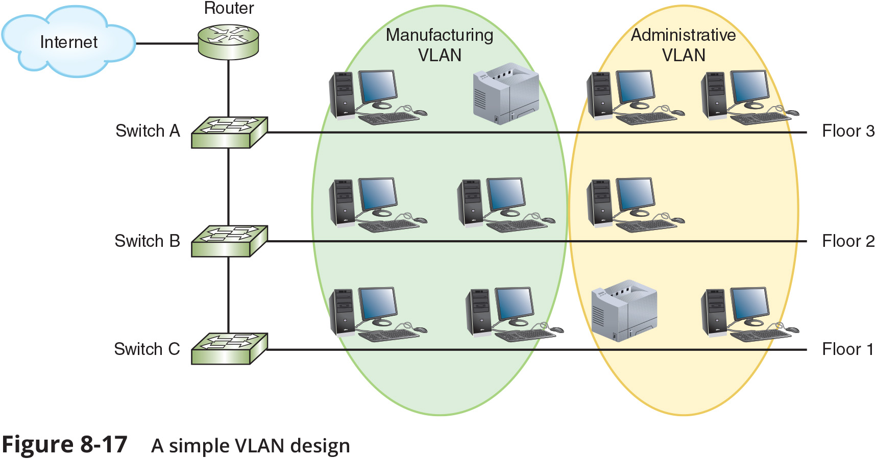
Virtual LANs (VLANS) (2 of 2)

Slide 4
Switch Port Configuration (1 of 5)
A managed switch can be configured via a CLI (command-line interface) or a web-based management GUI
VLANS can only be implemented through managed switches whose ports can be partitioned into groups
By sorting traffic based on layer 2 information, VLANs create two or more broadcast domains from a single broadcast domain

Slide 5
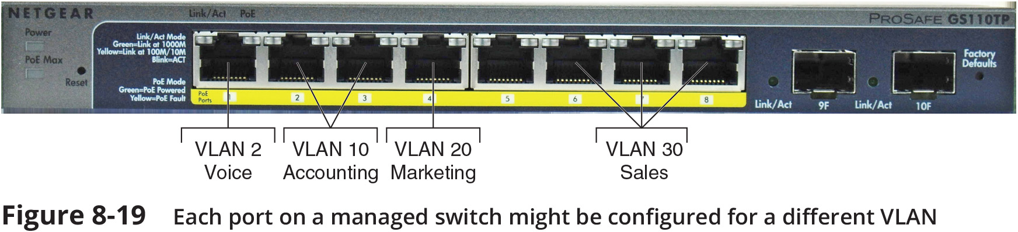
Switch Port Configuration (2 of 5)

Slide 6
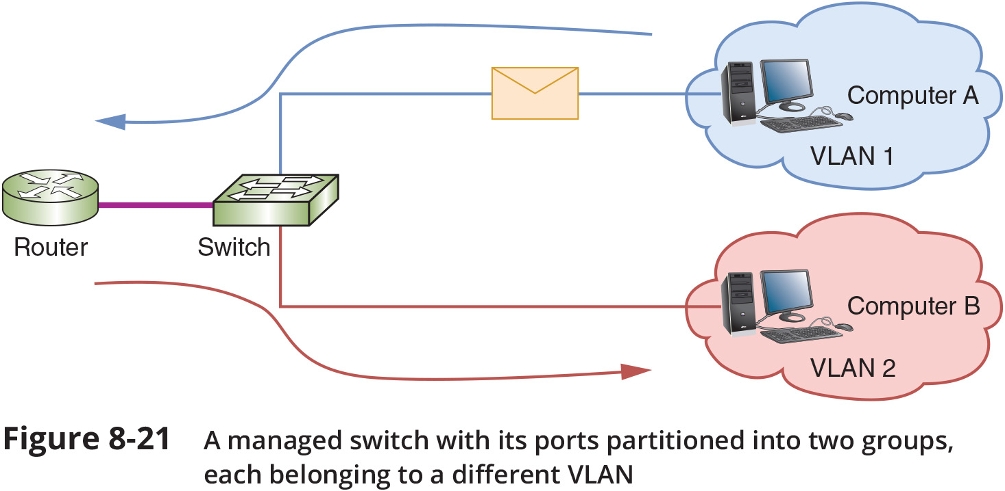
Switch Port Configuration (3 of 5)

Slide 7
Switch Port Configuration (4 of 5)
To identify the transmissions that belong to each VLAN, the switch adds a tag to Ethernet header that identifies the port through which messages arrive at the switch
The tag travels with the transmission until it reaches one of the following:
The switch port connected to the destination device, if the destination device is connected to the same switch as the sending device
A router for routing to the correct VLAN, if the destination device is connected to a different switch
If the frame is being routed to a new VLAN, the router adds a new tag
The tag is removed once the frame reaches its final switch port

Slide 8
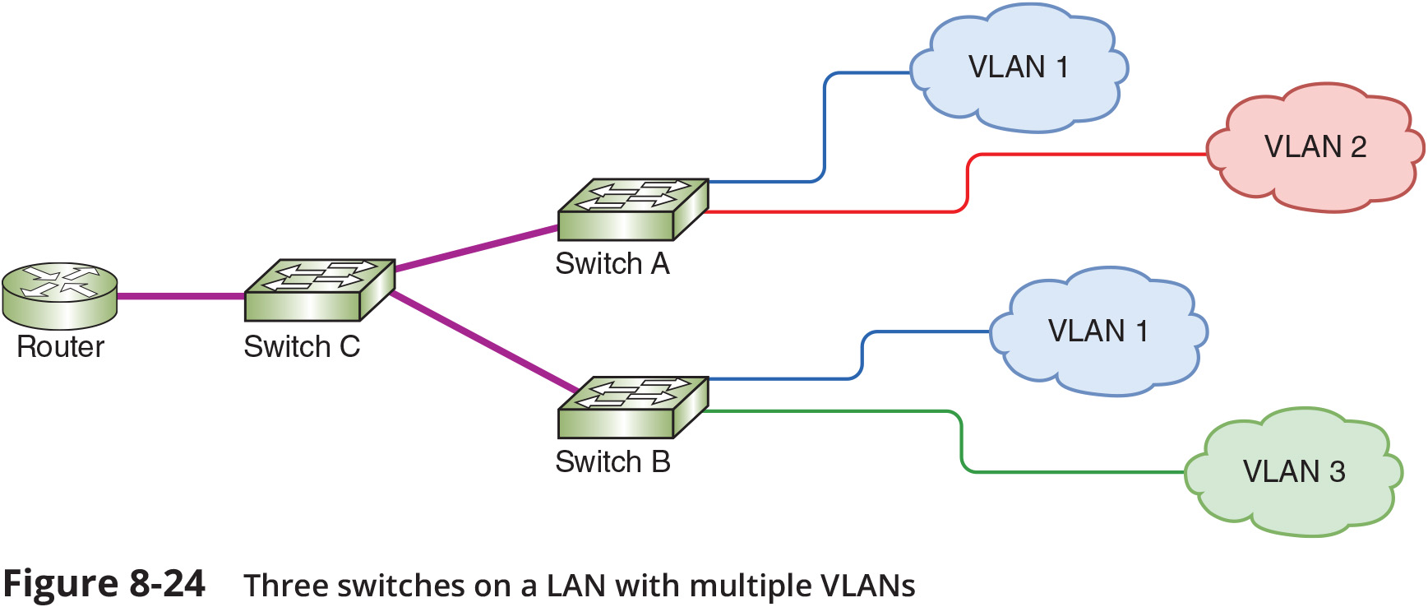
Switch Port Configuration (5 of 5)

